Slide 1


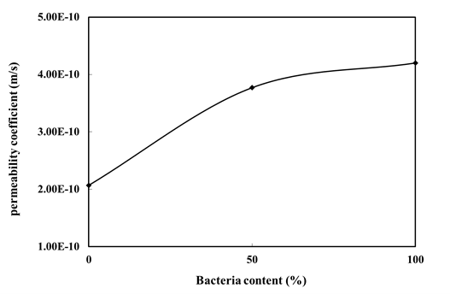
2nd Comprehensive Congress on the Prevention of Nosocomial Infections, Improvement of Healthcare Services, Medical Equipment, and Sterilization
Title
First Author ¹, Second Author ², et al.
¹ Affiliation and Short Address
Email
Introduction
The content of the Introduction The content of the Introduction The content of the Introduction The content of the Introduction The content of the Introduction The content of the Introduction The content of the Introduction The content of the Introduction The content of the Introduction The content of the Introduction The content of the Introduction The content of the Introduction The content of the Introduction The content of the Introduction The content of the Introduction The content of the Introduction The content of the Introduction.
Figure 1. Figure caption
The content of the Results The content of the Results The content of the Results The content of the Results The content of the Results The content of the Results The content of the Results The content of the Results The content of the Results The content of the Results The content of the Results The content of the Results The content of the Results The content of the Results The content of the Results The content of the Results The content of the Results The content of the Results The content of the Results The content of the Results The content of the Results.
Methodology
Methodology Methodology Methodology Methodology Methodology Methodology Methodology Methodology Methodology Methodology Methodology Methodology Methodology Methodology Methodology Methodology Methodology Methodology Methodology Methodology Methodology Methodology Methodology Methodology Methodology Methodology Methodology Methodology Methodology Methodology Methodology Methodology Methodology Methodology Methodology Methodology Methodology Methodology Methodology Methodology Methodology Methodology Methodology.
Conclusions
The content of the Conclusions The content of the Conclusions The content of the Conclusions The content of the Conclusions The content of the Conclusions The content of the Conclusions The content of the Conclusions The content of the Conclusions The content of the Conclusions The content of the Conclusions The content of the Conclusions The content of the Conclusions The content of the Conclusions The content of the Conclusions The content of the Conclusions.
Results
The content of the Results The content of the Results The content of the Results The content of the Results The content of the Results The content of the Results The content of the Results The content of the Results The content of the Results The content of the Results The content of the Results The content of the Results The content of the Results The content of the Results. The content of the Results The content of the Results The content of the Results The content of the Results The content of the Results The content of the Results The content of the Results The content of the Results.
Article code:
References
1. Areias, P. M. A. and Belytschko, T., (2005), “Analysis of Three-Dimensional Crack Initiation and Propagation Using the Extended Finite Element Method,” International Journal for Numerical Methods in Engineering, 63 (55), pp 760–788.
2. Atluri, S. N. and Shen, S., (2002), “The Meshless Local Petrov–Galerkin (MLPG) Method”, Tech Science Press, USA.
3. Udwadia, F. E. and Trifunac, M. D., (1973), “Ambient Vibration Test of Full Scale Structures,” Proc. of the 5th World Conf. On Earthquake Engineering, Rome, pp 135-142.
ARTICLE CODE : 1080

